Slide 1
AWS Overview

Slide 2
What is Cloud Computing?
Cloud computing is the on-demand delivery of compute power, database storage, applications and other IT resources through a cloud services platform via the Internet with pay-as-you-go pricing.
Cloud computing provides a simple way to access servers, storage, databases and a broad set of application services over the Internet.

Slide 3
6 Advantages of Cloud Computing
Trade capital expense for variable expense.
Benefit from massive economies of scale.
Stop guessing about capacity.
Increase speed and agility.
Eliminate overhead cost of maintaining data centers
Go global in minutes.

Slide 4
3 Models of Cloud Computing
Infrastructure as a Service (IaaS)
Infrastructure as a Service (IaaS) is a self-service model for managing remote data center infrastructures. AWS offers IaaS in the form of data centers.
Platform as a Service (PaaS)
Platform as a Service (PaaS) allows organizations to build, run and manage applications without the IT infrastructure. This makes it easier and faster to develop, test and deploy applications.
Software as a Service (SaaS)
Software as a service (SaaS) replaces the traditional on-device software with software that is licensed on a subscription basis. It is centrally hosted in the cloud. A good example is Salesforce.com.

Slide 5
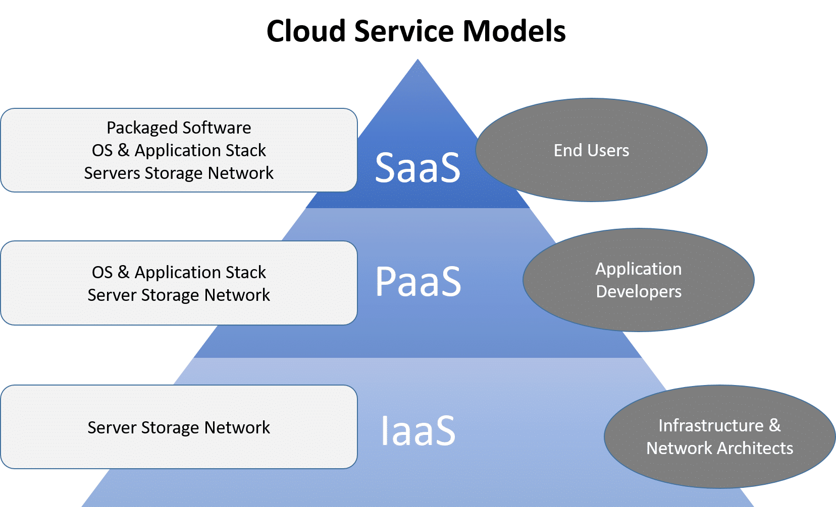
3 Models of Cloud Computing

Slide 6
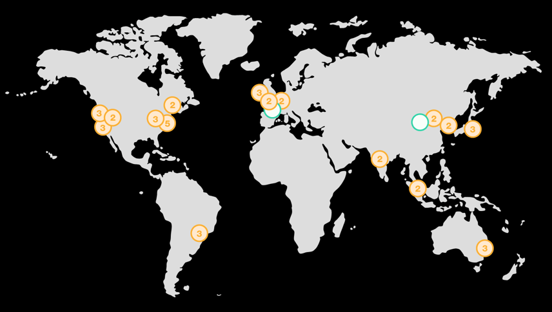
AWS Regions & Availability Zones
AWS now spans 77 Availability Zones within 24 geographic regions around the world, and has announced plans for nine more Availability Zones and three more AWS Regions in Indonesia, Japan, and Spain.

Slide 7
AWS Regions
An AWS Region is a geographical location with a collection of availability zones mapped to physical data centers in that region.
Every region is physically isolated from and independent of every other region in terms of location, power, water supply, etc.
This level of isolation is critical for workloads with compliance and data sovereignty requirements where guarantees must be made that user data does not leave a particular geographic region.
The presence of AWS regions worldwide is also important for workloads that are latency-sensitive and need to be located near users in a particular geographic area.
Inside each region, you will find two or more availability zones with each zone hosted in separate data centers from another zone.

Slide 8
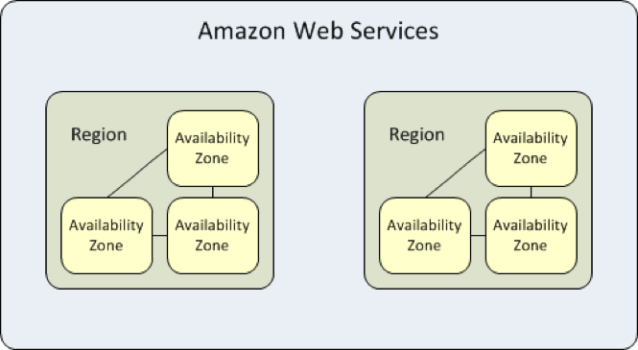
AWS Availability Zones
An availability zone is a logical data center in a region available for use by any AWS customer.
Each zone in a region has redundant and separate power, networking and connectivity to reduce the likelihood of two zones failing simultaneously.

Slide 9
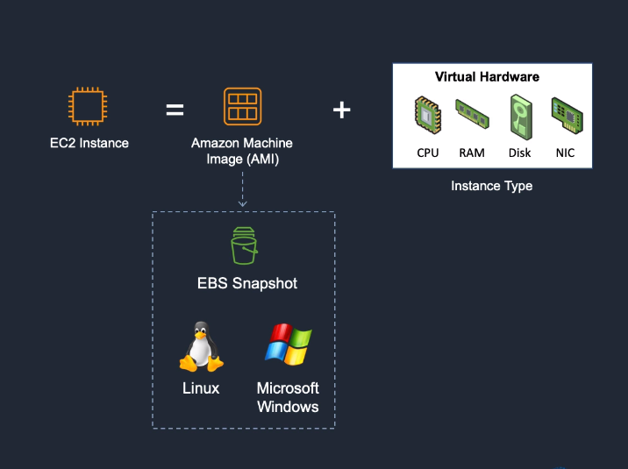
AWS Elastic Compute Cloud (EC2)
Amazon Elastic Compute Cloud (Amazon EC2) is a web service that provides secure, resizable compute capacity in the cloud.
It is designed to make web-scale cloud computing easier for developers.

Slide 10
AMAZON EC2 PROVIDES:
Virtual computing environments, known as instances
Preconfigured templates for your instances, known as Amazon Machine Images (AMIs), that package the bits you need for your server (including the operating system and additional software)
Various configurations of CPU, memory, storage, and networking capacity for your instances, known as instance types
Secure login information for your instances using key pairs (AWS stores the public key, and you store the private key in a secure place)
A firewall that enables you to specify the protocols, ports, and source IP ranges that can reach your instances using security groups

Slide 11
AMAZON EC2 PROVIDES
Elastic Web-Scale Computing
You can increase or decrease capacity within minutes and commission one to thousands of instances simultaneously.
Completely Controlled
AWS EC2 give you complete control including root access to each instance and can stop and start instances without losing data and use web service APIs.
Flexible Cloud Hosting Services
You can choose from multiple instance types & operating systems as well as instances with varying memory, CPU, and storage configurations.

Slide 12
AMAZON EC2 PROVIDES
Elasticity
The “Elastic” nature of the service allows developers to instantly scale to meet spikes in traffic or demand. When computing requirements unexpectedly change (up or down), Amazon EC2 can instantly respond, meaning that developers can control how many resources are in use at any given point in time.
Instances
An instance is a virtual server in the cloud. Its configuration at launch is a copy of the AMI that you specified when you launched the instance.

Slide 13
Create an EC2 Instance

Slide 14
How to SSH into an EC2
Your EC2 instance will be running in a public subnet.
Your EC2 instance has a public address on the internet which you are able to access from wherever you have internet access.
The relevant protocol by which we are able to access the instance is by using Secure Shell (SSH) which is the TCP protocol port 22.

Slide 15
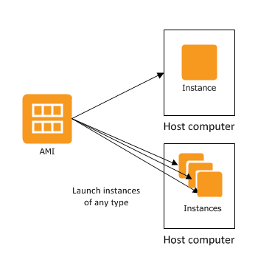
Amazon Machine Image (AMI)
An Amazon Machine Image (AMI) provides the information required to launch an instance. Think of it as a template for an EC2 Instance.
An AMI includes the following:
One or more EBS snapshots.
Launch permissions that control which AWS accounts can use the AMI to launch instances.
A block device mapping that specifies the volumes to attach to the instance when it's launched.

Slide 16
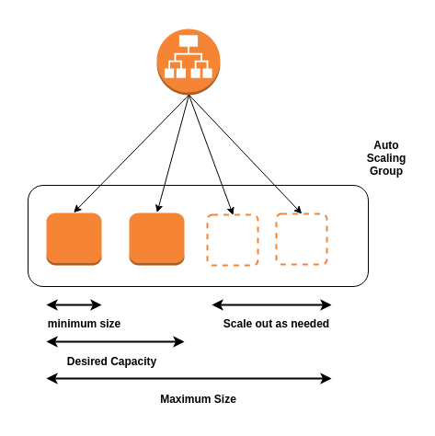
EC2 Autoscaling
Amazon EC2 Auto Scaling helps you maintain application availability and allows you to automatically add or remove EC2 instances according to conditions you define.
Benefits
Improve Fault Tolerance
Increase Application Availability
Lower Costs

Slide 17
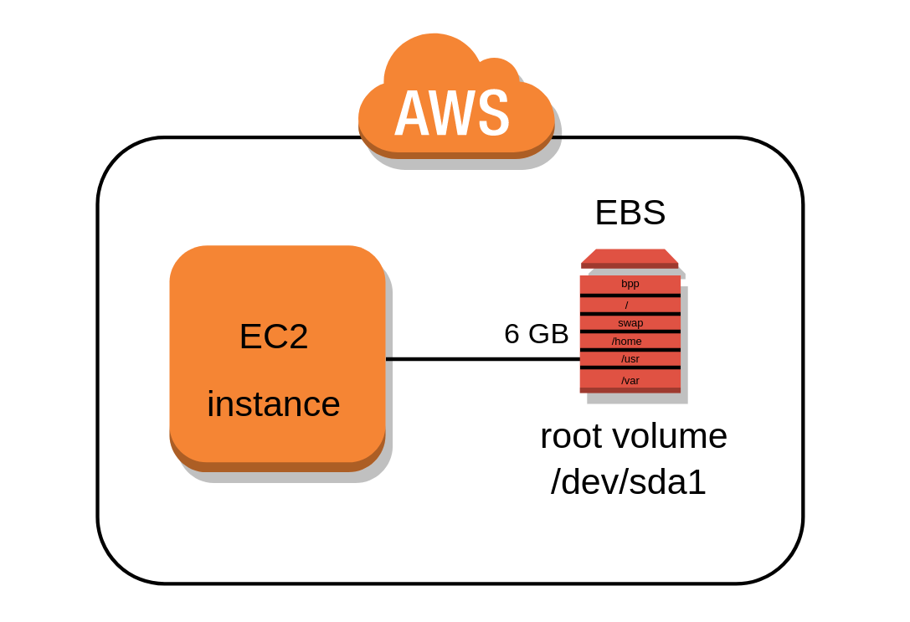
Amazon Elastic Block Store (Amazon EBS)
Amazon Elastic Block Store (Amazon EBS) provides block level storage volumes for use with EC2 instances.
EBS volumes behave like raw, unformatted block devices. You can mount these volumes as devices on your instances.
EBS volumes that are attached to an instance are exposed as storage volumes that persist independently from the life of the instance.
You can create a file system on top of these volumes, or use them in any way you would use a block device (such as a hard drive).
You can dynamically change the configuration of a volume attached to an instance.
With Amazon EBS, you pay only for what you use.

Slide 18
EBS Volumes
An Amazon EBS volume is a durable, block-level storage device that you can attach to your instances.
After you attach a volume to an instance, you can use it as you would use a physical hard drive.
You can use EBS volumes as primary storage for data that requires frequent updates, such as the system drive for an instance or storage for a database application.
EBS volumes are created in a specific Availability Zone, and can then be attached to any instances in that same Availability Zone.

Slide 19
EBS Snapshots
You can back up the data on your Amazon EBS volumes to Amazon S3 by taking point-in-time snapshots.
Snapshots are incremental backups, which means that only the blocks on the device that have changed after your most recent snapshot are saved.

Slide 20
Security Groups
A security group acts as a virtual firewall for your EC2 instances to control incoming and outgoing traffic based on their IP address.
Security group rules enable you to filter traffic based on protocols and port numbers.
Security groups are stateful — if you send a request from your instance, the response traffic for that request is allowed to flow in regardless of inbound security group rules. Responses to allowed inbound traffic are allowed to flow out, regardless of outbound rules.
You can add rules to each security group that allow traffic to or from its associated instances. You can modify the rules for a security group at any time.

